Slide 1
Azure Storage services
Session 6

Slide 2
In this class, you'll learn about some of the different storage options that are available in Azure Storage services, and the scenarios in which each storage option is appropriate.

Slide 3
Learning objectives
After completing this class, you'll be able to describe the benefits and usage of:
Azure Blob Storage
Azure Disk Storage
Azure Files
Azure Blob access tiers

Slide 4
Introduction
Suppose your company, has a number of product brochures, datasheets, product images, and other files that are related to marketing, sales, and support.
In the past, your company has been hosting these files on standalone web servers in your datacenter.
Your company is now in the process of migrating its applications to the cloud, and your development team is currently architecting new applications.

Slide 5
Your Chief Technology Officer (CTO) wants to migrate all of your marketing, sales, and support files to the cloud in order to take advantage of geographic distribution of your files.
This move also reduces the number of physical servers that your company maintains in your datacenter.
As part of your migration strategy, you need to determine the correct approach for your cloud-based storage infrastructure.

Slide 6
Azure Storage account
The Chief Technology Officer (CTO) for your company, has tasked your team with migrating all of your files to the cloud.
Your team has chosen Azure Storage, which is a service that you can use to store files, messages, tables, and other types of information.
Clients such as websites, mobile apps, desktop applications, and many other types of custom solutions can read data from and write data to Azure Storage.
Azure Storage is also used by infrastructure as a service virtual machines, and platform as a service cloud services.

Slide 7
To begin using Azure Storage, you first create an Azure Storage account to store your data objects.
You can create an Azure Storage account by using the Azure portal, PowerShell, or the Azure CLI.

Slide 8
Disk storage
Disk Storage provides disks for Azure virtual machines.
Applications and other services can access and use these disks as needed, similar to how they would in on-premises scenarios.
Disk Storage allows data to be persistently stored and accessed from an attached virtual hard disk.

Slide 9
Disks come in many different sizes and performance levels, from solid-state drives (SSDs) to traditional spinning hard disk drives (HDDs), with varying performance tiers.
You can use standard SSD and HDD disks for less critical workloads, premium SSD disks for mission-critical production applications.
Ultra disks for data-intensive workloads such as SAP HANA, top tier databases, and transaction-heavy workloads.
Azure has consistently delivered enterprise-grade durability for infrastructure as a service (Iaas) disks, with an industry-leading ZERO% annualized failure rate.

Slide 10
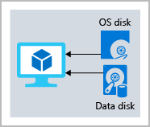
The following illustration shows an Azure virtual machine that uses separate disks to store different data.

Slide 11
Azure Blob storage
Azure Blob Storage is an object storage solution for the cloud.
It can store massive amounts of data, such as text or binary data.
Azure Blob Storage is unstructured, meaning that there are no restrictions on the kinds of data it can hold.
Blob Storage can manage thousands of simultaneous uploads, massive amounts of video data, constantly growing log files, and can be reached from anywhere with an internet connection.

Slide 12
Blobs aren't limited to common file formats.
A blob could contain gigabytes of binary data streamed from a scientific instrument, an encrypted message for another application, or data in a custom format for an app you're developing.
One advantage of blob storage over disk storage is that it does not require developers to think about or manage disks; data is uploaded as blobs, and Azure takes care of the physical storage needs.

Slide 13
Blob Storage is ideal for:
Serving images or documents directly to a browser.
Storing files for distributed access.
Streaming video and audio.
Storing data for backup and restore, disaster recovery, and archiving.
Storing data for analysis by an on-premises or Azure-hosted service.
Storing up to 8 TB of data for virtual machines.
You store blobs in containers, which helps you organize your blobs depending on your business needs.

Slide 14
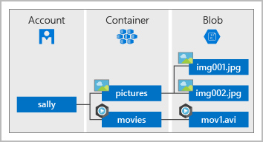
The following diagram illustrates how you might use Azure accounts, containers, and blobs.

Slide 15
Azure Files
Azure Files offers fully managed file shares in the cloud that are accessible via the industry standard Server Message Block and Network File System (preview) protocols.
Azure file shares can be mounted concurrently by cloud or on-premises deployments of Windows, Linux, and macOS.
Applications running in Azure virtual machines or cloud services can mount a file storage share to access file data, just as a desktop application would mount a typical SMB share.

Slide 16
Any number of Azure virtual machines or roles can mount and access the file storage share simultaneously.
Typical usage scenarios would be to share files anywhere in the world, diagnostic data, or application data sharing.

Slide 17
Use Azure Files for the following situations:
Many on-premises applications use file shares. Azure Files makes it easier to migrate those applications that share data to Azure. If you mount the Azure file share to the same drive letter that the on-premises application uses, the part of your application that accesses the file share should work with minimal changes, if any.
Store configuration files on a file share and access them from multiple VMs. Tools and utilities used by multiple developers in a group can be stored on a file share, ensuring that everybody can find them, and that they use the same version.
Write data to a file share, and process or analyze the data later. For example, you might want to do this with diagnostic logs, metrics, and crash dumps.

Slide 18
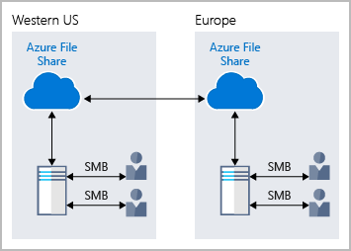
The following illustration shows Azure Files being used to share data between two geographical locations. Azure Files ensures the data is encrypted at rest, and the SMB protocol ensures the data is encrypted in transit.

Slide 19
One thing that distinguishes Azure Files from files on a corporate file share is that you can access the files from anywhere in the world, by using a URL that points to the file.
You can also use Shared Access Signature (SAS) tokens to allow access to a private asset for a specific amount of time.

Slide 20
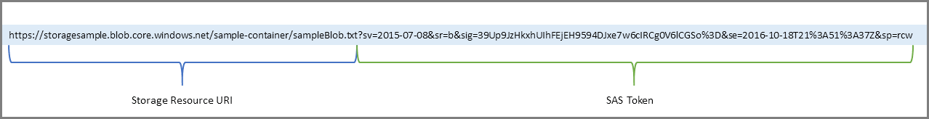
Here's an example of a service SAS URI, showing the resource URI and the SAS token:

Slide 21
Blob access tiers
Data stored in the cloud can grow at an exponential pace.
To manage costs for your expanding storage needs, it's helpful to organize your data based on attributes like frequency of access and planned retention period.
Data stored in the cloud can be different based on how it's generated, processed, and accessed over its lifetime.

Slide 22
Some data is actively accessed and modified throughout its lifetime.
Some data is accessed frequently early in its lifetime, with access dropping drastically as the data ages.
Some data remains idle in the cloud and is rarely, if ever, accessed after it's stored.
To accommodate these different access needs, Azure provides several access tiers, which you can use to balance your storage costs with your access needs.

Slide 23
Azure Storage offers different access tiers for your blob storage, helping you store object data in the most cost-effective manner.
The available access tiers include:
Hot access tier
Cool access tier
Archive access tier

Slide 24
Hot access tier:
Optimized for storing data that is accessed frequently (for example, images for your website).

Slide 25
Cool access tier:
Optimized for data that is infrequently accessed and stored for at least 30 days (for example, invoices for your customers).

Slide 26
Archive access tier:
Appropriate for data that is rarely accessed and stored for at least 180 days, with flexible latency requirements (for example, long-term backups).

Slide 27
The following considerations apply to the different access tiers:
Only the hot and cool access tiers can be set at the account level.
The archive access tier isn't available at the account level.
Hot, cool, and archive tiers can be set at the blob level, during upload or after upload.
Data in the cool access tier can tolerate slightly lower availability, but still requires high durability, retrieval latency, and throughput characteristics similar to hot data.

Slide 28
For cool data, a slightly lower availability service-level agreement (SLA) and higher access costs compared to hot data are acceptable trade-offs for lower storage costs.
Archive storage stores data offline and offers the lowest storage costs, but also the highest costs to rehydrate and access data.
The following illustration demonstrates choosing between the hot and cool access tiers on a general purpose storage account.

Slide 29
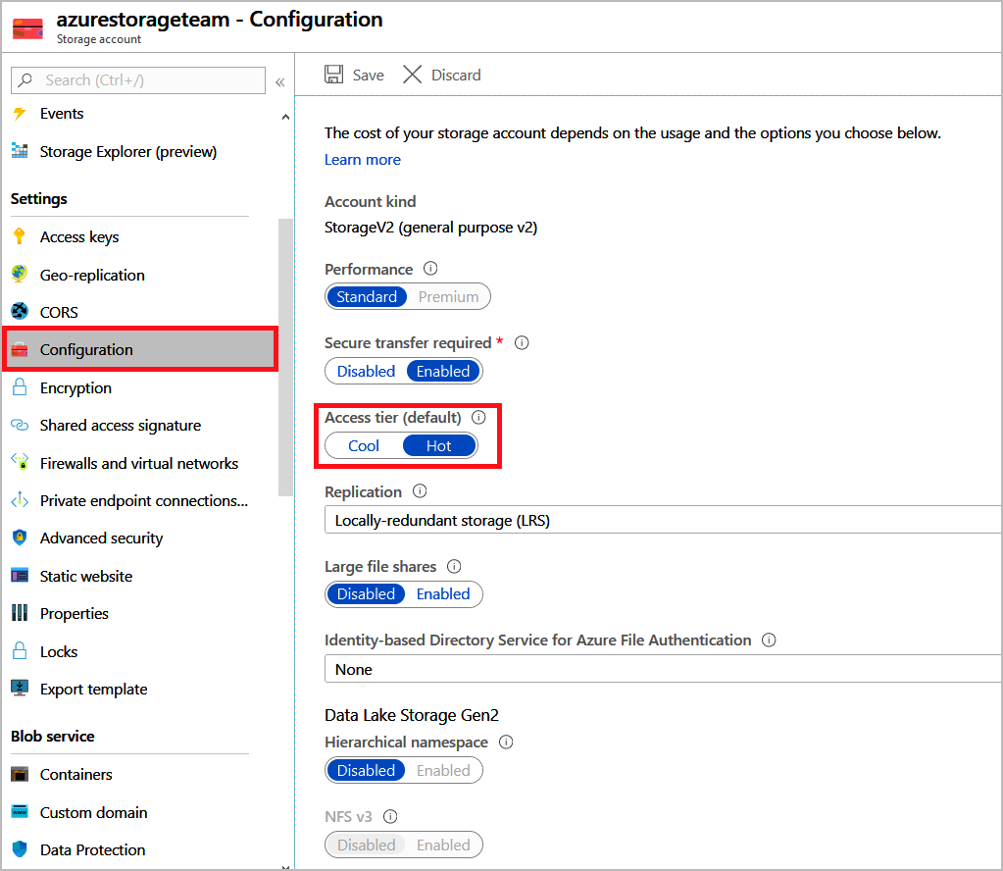

Slide 30
In this class, you discovered how Azure Storage can provide your company with a variety of options for storing your data.
For example, you learned that your first step when using Azure Storage is to create a storage account.
After you've done so, Azure provides you with several options for storing your data:
Azure Blob Storage
Azure Disk Storage
Azure Files Storage

Slide 31
storage account
An Azure storage account contains all of your Azure Storage data objects: blobs, files, queues, and tables.
The storage account provides a unique namespace for your Azure Storage data that is accessible from anywhere in the world over HTTP or HTTPS.
You will learn to create a storage account using the Azure portal

Slide 32
Create a storage account
A storage account is an Azure Resource Manager resource.
Resource Manager is the deployment and management service for Azure.
Every Resource Manager resource, including an Azure storage account, must belong to an Azure resource group.
A resource group is a logical container for grouping your Azure services.
When you create a storage account, you have the option to either create a new resource group, or use an existing resource group.

Slide 33
To create an Azure storage account with the Azure portal, follow these steps:
From the left portal menu, select Storage accounts to display a list of your storage accounts.
On the Storage accounts page, select Create.
Options for your new storage account are organized into tabs in the Create a storage account page.
The following sections describe each of the tabs and their options.

Slide 34
Basics tab
On the Basics tab, provide the essential information for your storage account.
After you complete the Basics tab, you can choose to further customize your new storage account by setting options on the other tabs, or you can select Review + create to accept the default options and proceed to validate and create the account.

Slide 35
Advanced tab
On the Advanced tab, you can configure additional options and modify default settings for your new storage account.
Some of these options can also be configured after the storage account is created, while others must be configured at the time of creation.

Slide 36
Enable secure transfer | Enable secure transfer to require that incoming requests to this storage account are made only via HTTPS (default).
Enable infrastructure encryption | By default, infrastructure encryption is not enabled. Enable infrastructure encryption to encrypt your data at both the service level and the infrastructure level.
Enable blob public access | When enabled, this setting allows a user with the appropriate permissions to enable anonymous public access to a container in the storage account (default).
Access tier | Blob access tiers enable you to store blob data in the most cost-effective manner, based on usage. Select the hot tier (default) for frequently accessed data. Select the cool tier for infrequently accessed data.
Enable large file shares | Available only for standard file shares with the LRS or ZRS redundancies.

